Slide 1

Student Details
Name : VEMULA PUJA
E-MAIL ID : vemulapooja857@gmail.com
COLLEGE NAME : ANDHRA LOYOLA INSTITUTE OF ENGINEERING & TECHNOLOGY, ANDHRA PRADESH
DOMAIN OF INTERNSHIP : CYBER SECURITY
START AND END DATE : JUN 7,2024 TO JUL 12,2024

Slide 2
PROJECT TITLE/Problem Statement
HIDING A TEXT INSIDE THE IMAGE USING STEGANOGRAPHY

Slide 3
AGENDA
The main purpose of steganography is to hide the existence of secret information within an innocuous cover medium, such as an image, audio file, or video. Unlike encryption, which focuses on securing data by making it unreadable without a decryption key.
steganography conceals the fact that secret information is being communicated. This covert communication aims to ensure privacy and confidentiality by making it difficult for unintended recipients to detect or intercept the hidden data.

Slide 4
PROJECT OVERVIEW
Our steganography tool provides a robust, versatile, and user-friendly solution for hiding and protecting sensitive data within digital media. By offering advanced features and strong security measures, we ensure that our users can confidently secure their information and maintain their privacy in an increasingly digital world.

Slide 5
OBJECTIVES
Enhance Data Security:
Provide a secure method for embedding hidden messages within digital media to protect sensitive information.
Educational Resource:
Serve as a comprehensive learning tool for students and professionals in the field of cybersecurity.
User-Friendly Interface:
Develop an intuitive and accessible user interface that caters to both beginners and advanced users.
Advanced Features:
Incorporate cutting-edge steganography and steganalysis techniques to ensure robustness and reliability.

Slide 6
WHO ARE THE END USERS of this project?
Cybersecurity Professionals
Use steganography to protect sensitive information and enhance data security.
Develop and implement steganalysis techniques to detect hidden data in digital communications.
Journalists and Whistleblowers
Use steganography to safely share sensitive information without revealing their sources or risking exposure.
Law Enforcement and Intelligence Agencies
Detect and analyze hidden communications used by criminals and terrorists.
Software Developers and Researchers
Develop new steganography algorithms and tools.

Slide 7
WHO ARE THE END USERS of this project?
Digital Artists and Content Creators:
Embed watermarks and copyright information in digital media to protect intellectual property.
Corporate Users:
Protect trade secrets and confidential business information.
Ensure secure communication within the organization.
Educational Institutions:
Teach students about data security, steganography techniques, and digital forensics.

Slide 8
YOUR SOLUTION AND ITS VALUE PROPOSITION
.
Our solution provides a comprehensive steganography tool that allows users to embed hidden messages within various types of digital media such as images, audio files, and videos. The tool leverages advanced algorithms to ensure that the hidden data is imperceptible to human senses and resistant to detection by steganalysis techniques.
Value Proposition:
Enhanced Security : Our solution enhances the security of sensitive information by providing a layer of protection.
Versatile Applications : Suitable for wide range of users.
Cost-Effective : Provides a cost effective solution for securing data without expensive hard or software.
Continuous Improvement : Regular updates and improvement.
Ease of use : Designed with user experience in mind.

Slide 9
How did you customize the project and make it your own
In customizing a steganography project, one approach could be to focus on developing a user-friendly interface with advanced encryption techniques.
For instance, integrating AES (Advanced Encryption Standard) for data encryption within images could enhance security.
Additionally, implementing a unique method for embedding data, such as LSB (Least Significant Bit) replacement, could be tailored to handle larger data payloads or improve embedding efficiency.
These customizations aim to enhance both security and usability, making the steganography tool more robust and practical for various applications.

Slide 10
MODELLING
.
Image Processing Module:
Load image from specified path.
Check if image is successfully loaded.
Get image dimensions (height, width, channels).
Save modified image to a new file.
Open the newly saved encrypted image.
Steganography Algorithm Module:
Loop through the secret message and encode each character into the image.
Use the hashed password to modify pixel values securely.
Cryptographic Module:
Prompt user for secret message and password.
Use the hashed password to ensure secure encoding.

Slide 11
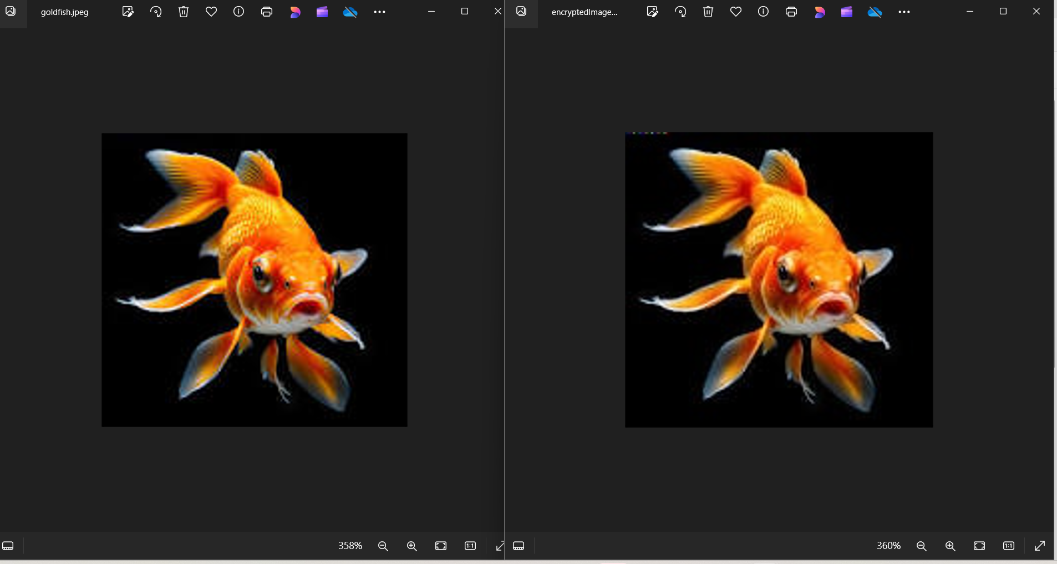
Results

Slide 12
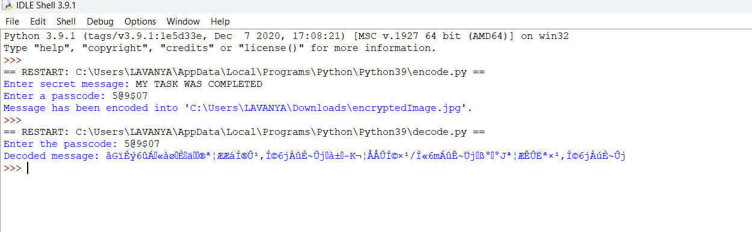
Results

Slide 13
links

